Slide 1
Autumn Hawkbit Dissection
Scorzoneroides autumnalis (L.) Moench.

Slide 2
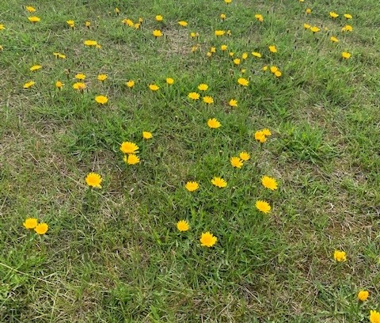
Habitat

Slide 3
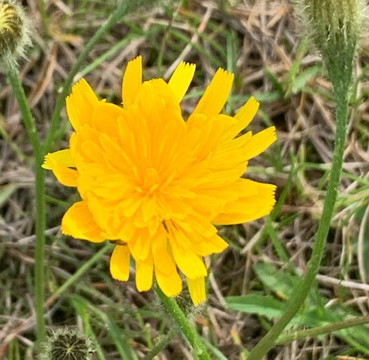
Overview of Inflorescence

Slide 4
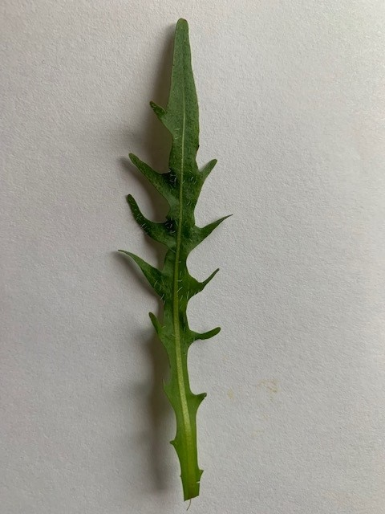
Upper Leaf
Adaxial

Slide 5
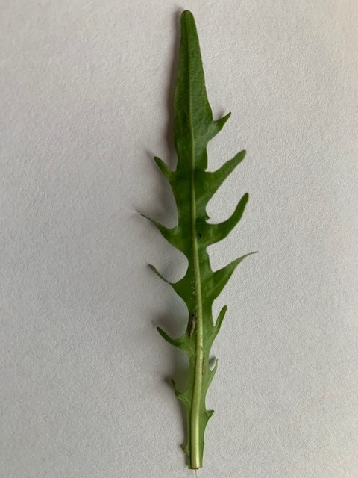
Lower Leaf
Abaxial
May be dentate or lobed leaves

Slide 6
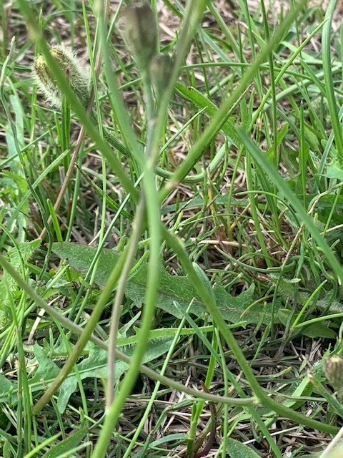
Stems & Leaves

Slide 7
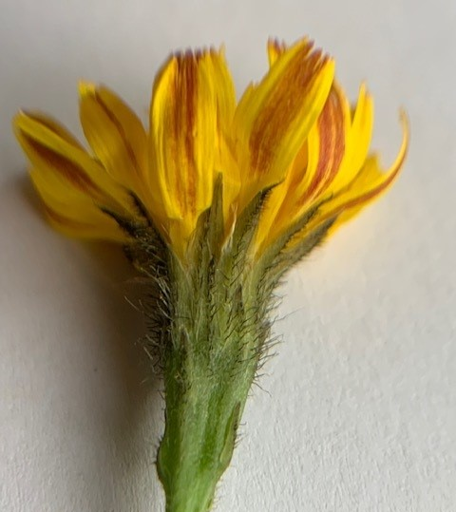
Side view of inflorescence with ligulate florets
Ligulate florets
Multiple ligulate florets (six yellow with orange stripe visible here, they have 5 teeths at the end)
Receptacle with tiny hairy black trichomes on the phyllaries that form the involucre
phyllaries
Receptacle

Slide 8
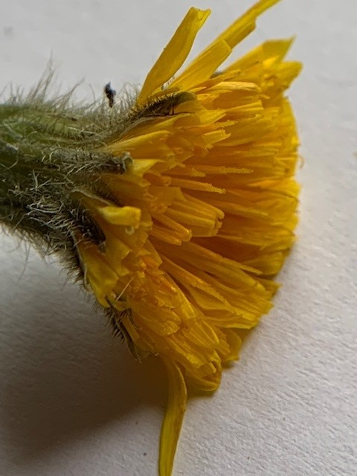
Side View of
head of flowers
- showing trichomes
on the phyllaries
- And numerous ligulate florets
no disk florets present

Slide 9
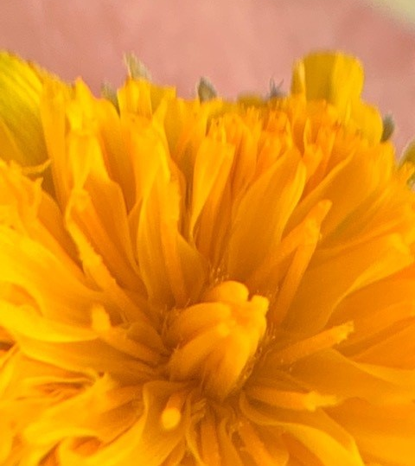
Top View of head of flowers
May be ovary in center (but I’m not sure)
I’m guessing thin circular ‘stemlets’ in center may be stigmas and those in center are still separating
Adnation

Slide 10
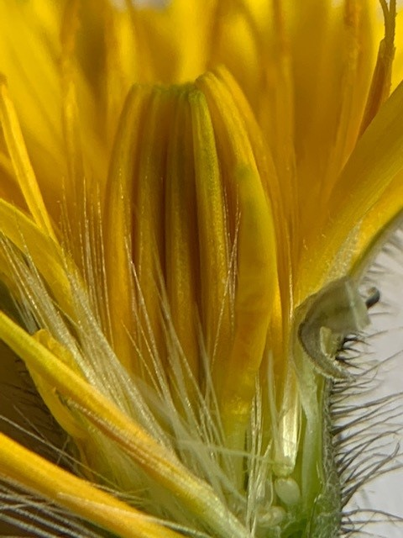
Vertical Dissection
Ligulate florets
Pappus of long feathery bristles
Remnants of the calyx attaches
above the ovary
This
Seen here are the ovaries at the base (inferior ovary)
Adnation of pappus to the top of the ovary
And yellow ligulate florets
The center florets have not yet opened up
trichomes
on phyllaries
ovary

