Slide 1
Fireweed Dissection
Chamaenerion angustifolium

Slide 2
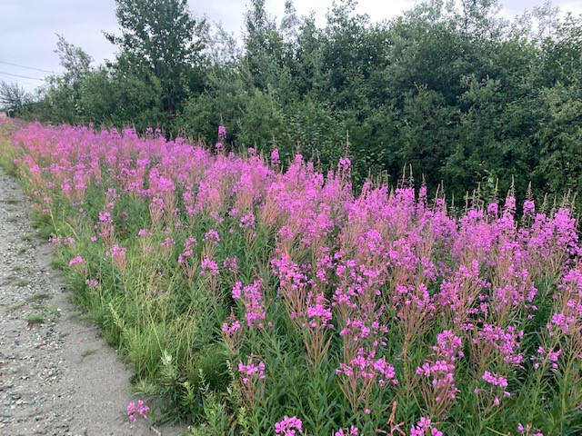
Habitat

Slide 3
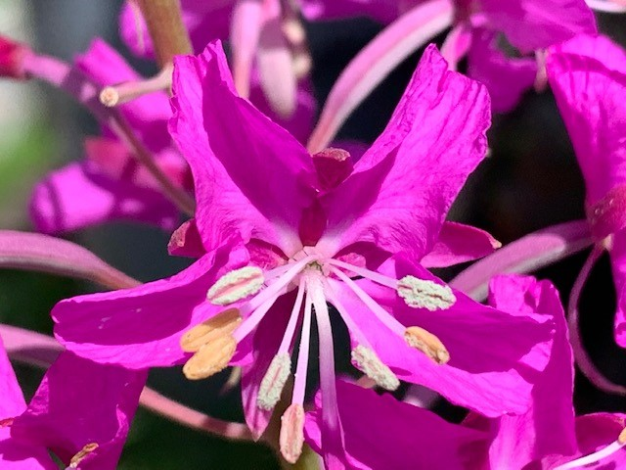
Overview of florescence
Four Petals
Eight Stamens
Stigma on top of style
Connation

Slide 4
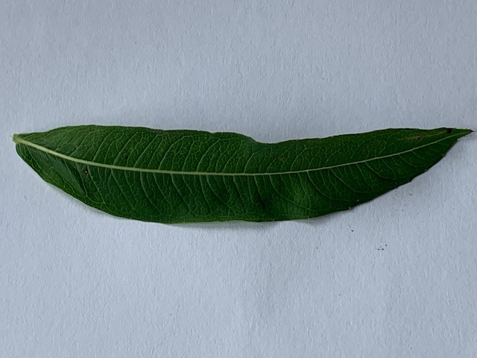
Upper Leaf
Adaxial lamina
Entire linear leaf
Venation-primary (mid) and secondary veins (pinnate)
Base of leaf is the petiole (where it attaches to stem) and the apex
petiole

Slide 5
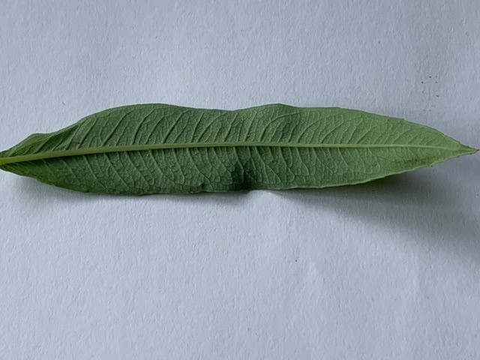
Lower Leaf
Abaxial lamina
Prominent midvein (primary vein)
Venation is looping around (secondary veins)

Slide 6
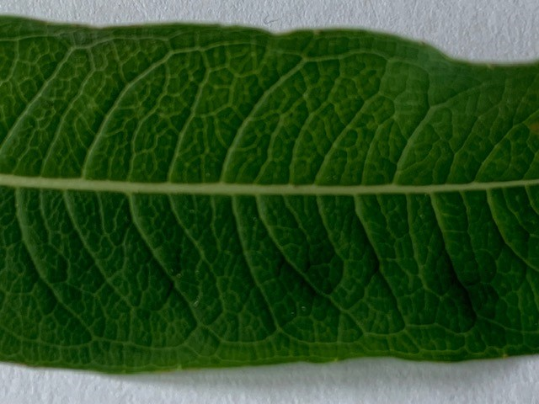
Leaf Venation
Ovate Leaf
Stalk
Venation

Slide 7
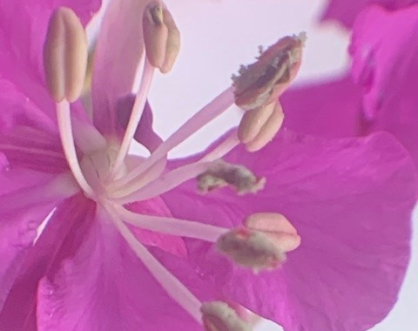
Fireweed
8 Stamens
8 Anthers on tips. which open longitudinally

Slide 8
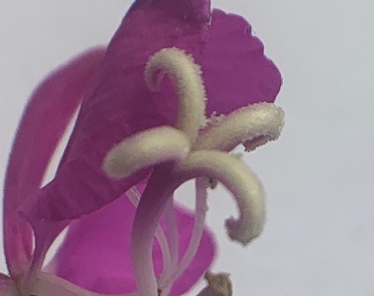
Fireweed
Open four-lobed stigma on the style

